Slide 1
AUTOMATION IS FOR HUMANS

Slide 2
IT Value
Notes:
Markets are changing
Business can no longer view IT to be the bottleneck
IT needs to be a competitive edge
Every company is now an IT company
Bring up hospitals - Scanned
To put a buzzword on it...

Slide 3
Digital Transformation
Notes:
To label it with a buzzword

Slide 4
Obstacles
Notes:
Challenges facing IT to be valuable
Handoffs
Ticket queues are where productivity goes to die
Biggest Queues are the biggest bottlenecks
Quality is low
Hand built - Config Drift
Slow
Not innovative - Workers are repeating and not innovating.
Compliance

Slide 5
Complexity Kills Productivity
Notes:
Challenges facing IT to be valuable
Handoffs
Ticket queues are where productivity goes to die
Biggest Queues are the biggest bottlenecks
Quality is low
Hand built - Config Drift
Slow
Not innovative - Workers are repeating and not inoovating.

Slide 6



Good IT has
Quality
Speed
Agility
1

Slide 7
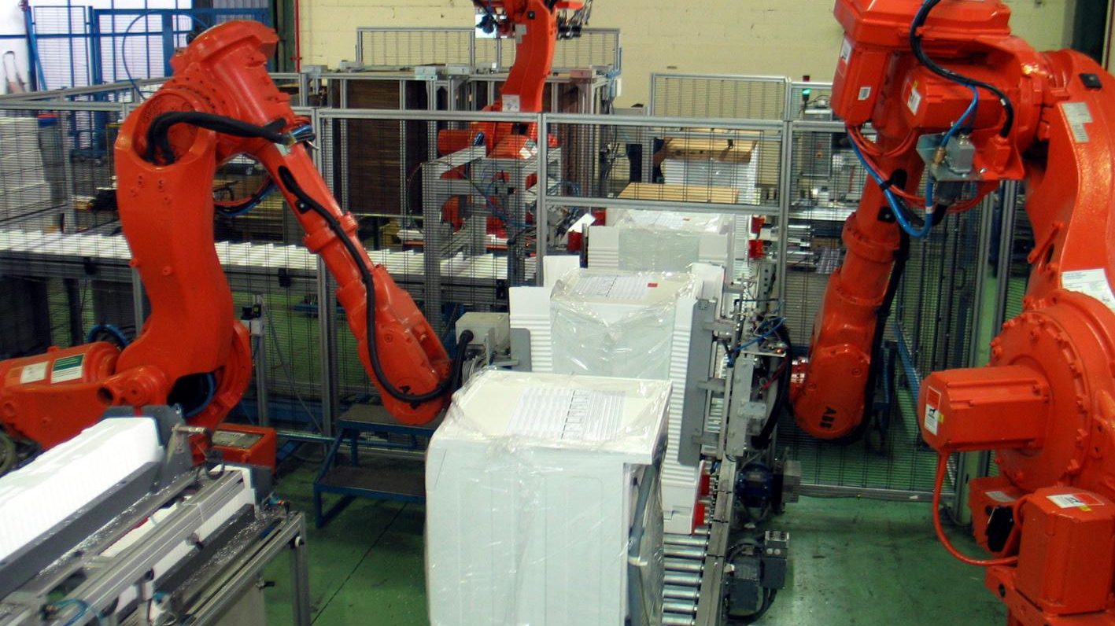
1
Notes:
How does Automation Help us?

Slide 8
Consistency
Notes:
Automation does the same thing over and over again
Consistency drives quality
Toyota example

Slide 9
Service
Notes:
Automation does the same thing over and over again
Rails can be offered to other teams

Slide 10
Speed
Notes:
Automation does the same thing over and over again
Robots can build pieces faster than humans can
Toyota example

Slide 11
Human Elevation
Notes:
Focus on what humans do best
Human elevation allows for Empathic team work.

Slide 12

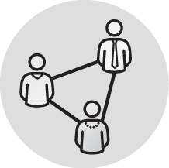
Engineering with Empathy
Development
Operations
DevOps
1
Notes:
Consistency builds trust
Service builds on that trust
Speed comes from service to each other
Enable Development teams building apps to work with operations teams supporting those apps
In other words… devops

Slide 13

1
Notes:
If we could describe our perfect automation...

Slide 14
Perfect Automation
What do we want our automation to look and feel like?
Simple
Powerful
Universal
Speak a Common Language!
1

Slide 15

ANSIBLE
THE LANGUAGE OF DEVOPS

Slide 16



WHY ANSIBLE?
POWERFUL
AGENTLESS
SIMPLE
Human readable automation
No special coding skills needed
Tasks executed in order
Usable by every team
Get productive quickly
App deployment
Configuration management
Workflow orchestration
Network automation
Orchestrate the app lifecycle
Agentless architecture
Uses OpenSSH & WinRM
No agents to exploit or update
Get started immediately
More efficient & more secure

Slide 17
WHY ANSIBLE?
POWERFUL
AGENTLESS
SIMPLE
Human readable automation
No special coding skills needed
Tasks executed in order
Usable by every team
Get productive quickly
App deployment
Configuration management
Workflow orchestration
Network automation
Orchestrate the app lifecycle
Agentless architecture
Uses OpenSSH & WinRM
No agents to exploit or update
Get started immediately
More efficient & more secure

Slide 18


COMMUNICATION IS THE KEY TO DEVOPS
ANSIBLE PLAYBOOK
From development…
…to production.
DEV/TEST
Q/A
OPERATIONS
MANAGEMENT
OUTSOURCERS
Ansible is the first automation language that can be read and written across IT.
Ansible is the only automation engine that can automate the entire application lifecycle and continuous delivery pipeline.

Slide 19
PLAYBOOK EXAMPLE
---
- name: install and start apache
hosts: web
become: yes
vars:
http_port: 80
tasks:
- name: httpd package is present
yum:
name: httpd
state: latest
- name: latest index.html file is present
copy:
src: files/index.html
dest: /var/www/html/
- name: httpd is started
service:
name: httpd
state: started
---
- name: install and start apache
hosts: web
become: yes
vars:
http_port: 80
tasks:
- name: httpd package is present
yum:
name: httpd
state: latest
- name: latest index.html file is present
copy:
src: files/index.html
dest: /var/www/html/
- name: httpd is started
service:
name: httpd
state: started
---
- name: install and start apache
hosts: web
become: yes
vars:
http_port: 80
tasks:
- name: httpd package is present
yum:
name: httpd
state: latest
- name: latest index.html file is present
copy:
src: files/index.html
dest: /var/www/html/
- name: httpd is started
service:
name: httpd
state: started
---
- name: install and start apache
hosts: web
become: yes
vars:
http_port: 80
tasks:
- name: httpd package is present
yum:
name: httpd
state: latest
- name: latest index.html file is present
copy:
src: files/index.html
dest: /var/www/html/
- name: httpd is started
service:
name: httpd
state: started
---
- name: install and start apache
hosts: web
become: yes
vars:
http_port: 80
tasks:
- name: httpd package is present
yum:
name: httpd
state: latest
- name: latest index.html file is present
copy:
src: files/index.html
dest: /var/www/html/
- name: httpd is started
service:
name: httpd
state: started
---
- name: install and start apache
hosts: web
become: yes
vars:
http_port: 80
tasks:
- name: httpd package is present
yum:
name: httpd
state: latest
- name: latest index.html file is present
copy:
src: files/index.html
dest: /var/www/html/
- name: httpd is started
service:
name: httpd
state: started
Notes:
Playbook example:
The name fields are human-readable comments. Optional, but useful as comments to the Playbook. These strings also show up in Tower, so it is easy to correlate any failures in a long running Playbook.
Inventory call-out
Variables can be handled in several different ways:
Directly in the playbook
As part of a separate vars file
Via the command line
As output from a previous play
Via Tower
You are not required to use root as the remote user. You can have Ansible connect and run the playbook as any user or even multiple users – as long as that user has the permission to perform the tasks in the playbook. You can even use multiple users and specify different users for different plays or tasks.
Ansible supports sudo, su, powerbroker, and other privilege escalation mechanisms.
The real work. General format:
<<module>>: key=value

Slide 20
WHY ANSIBLE?
POWERFUL
AGENTLESS
SIMPLE
Human readable automation
No special coding skills needed
Tasks executed in order
Usable by every team
Get productive quickly
App deployment
Configuration management
Workflow orchestration
Network automation
Orchestrate the app lifecycle
Agentless architecture
Uses OpenSSH & WinRM
No agents to exploit or update
Get started immediately
More efficient & more secure

Slide 21
WHAT CAN I DO WITH ANSIBLE?
Automate the deployment and management of your entire IT footprint.
Do this...
Orchestration
Configuration Management
Application Deployment
Provisioning
Continuous Delivery
Security and Compliance
On these...
Firewalls
Load Balancers
Applications
Containers
Clouds
Servers
Infrastructure
Storage
Network Devices
And more...

Slide 22
ANSIBLE SHIPS WITH OVER 1250 MODULES
CLOUD
VIRT AND CONTAINER
WINDOWS
NETWORK
NOTIFY
AWS
Azure
CenturyLink
CloudScale
Digital Ocean
Docker
Google
Linode
OpenStack
Rackspace
And more...
Docker
VMware
RHEV
OpenStack
OpenShift
Atomic
CloudStack
And more...
ACLs
Files
Commands
Packages
IIS
Regedits
Shell
Shares
Services
Configs
Users
Domains
And more...
Arista
A10
Cumulus
Big Switch
Cisco
Cumulus
Dell
F5
Juniper
Palo Alto
OpenSwitch
And more...
HipChat
IRC
Jabber
Email
RocketChat
Sendgrid
Slack
Twilio
And more...

Slide 23
WHY ANSIBLE?
POWERFUL
AGENTLESS
SIMPLE
Human readable automation
No special coding skills needed
Tasks executed in order
Usable by every team
Get productive quickly
App deployment
Configuration management
Workflow orchestration
Network automation
Orchestrate the app lifecycle
Agentless architecture
Uses OpenSSH & WinRM
No agents to exploit or update
Get started immediately
More efficient & more secure

Slide 24

ANSIBLE WINDOWS AUTOMATION
Use Ansible to deploy and manage Windows
systems and applications.
70+
Windows Modules
350+
Powershell DSC resources
ansible.com/windows

Slide 25

ANSIBLE NETWORK AUTOMATION
Use Ansible to manage, validate, and continuously track heterogeneous network device configurations and deployments.
Network modules are included as part of the Ansible distribution.
33+
Networking platforms
460+
Networking Modules
ansible.com/networking

Slide 26



AUTOMATION FOR TEAMS
Allowing for Service Oriented Collaboration

Slide 27


RED HAT ANSIBLE TOWER
Scale + operationalize your automation
CONTROL
KNOWLEDGE
DELEGATION
RED HAT ANSIBLE ENGINE
Support for your Ansible automation
SIMPLE
POWERFUL
AGENTLESS
FUELED BY AN INNOVATIVE OPEN SOURCE COMMUNITY
Notes:
Control: scheduled and centralized jobs
Knowledge: Visibility and compliance
Delegation: Role-based access and self service
Simple: Everyone speaks the same language
Powerful: Designed for multi-tier deployments
Agentless: Predictable, reliable and secure

Slide 28







….
ANSIBLE CLI & CI SYSTEMS
ADMINS
ANSIBLE PLAYBOOKS
ANSIBLE TOWER
ROLE-BASED ACCESS CONTROL
KNOWLEDGE & VISIBILITY
SCHEDULED & CENTRALIZED JOBS
SIMPLE USER INTERFACE
TOWER API
USERS
ANSIBLE
OPEN SOURCE MODULE LIBRARY
PLUGINS
PYTHON CODEBASE
TRANSPORT SSH, WINRM, ETC.
AUTOMATE YOUR ENTERPRISE
INFRASTRUCTURE
LINUX, WINDOWS,
UNIX …
NETWORKS
ARISTA, CISCO, JUNIPER …
CONTAINERS
DOCKER,
LXC …
CLOUD
AWS, GOOGLE CLOUD, AZURE …
SERVICES
DATABASES,
LOGGING, SOURCE CONTROL MANAGEMENT…
USE CASES
PROVISIONING
CONFIGURATION
MANAGEMENT
APP DEPLOYMENT
CONTINUOUS DELIVERY
SECURITY & COMPLIANCE
ORCHESTRATION
Notes:
Platform overview

Slide 29
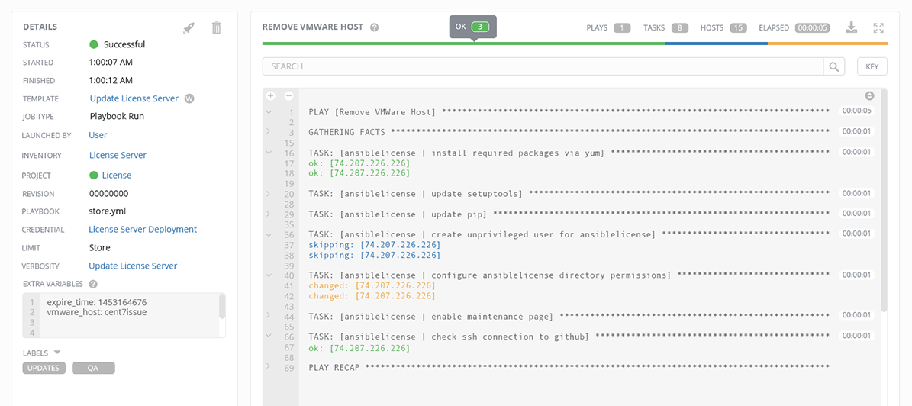
ANSIBLE TOWER
JOB STATUS UPDATE Heads-up NOC-style automation dashboard displays everything going on in your Ansible environment.

Slide 30
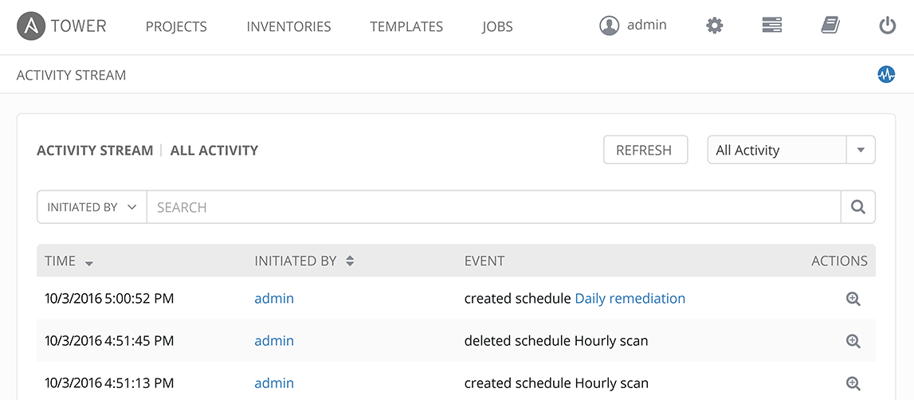
ANSIBLE TOWER
ACTIVITY STREAM Securely stores every Job that runs, and enables you to view them later, or export details through Tower’s API.

Slide 31
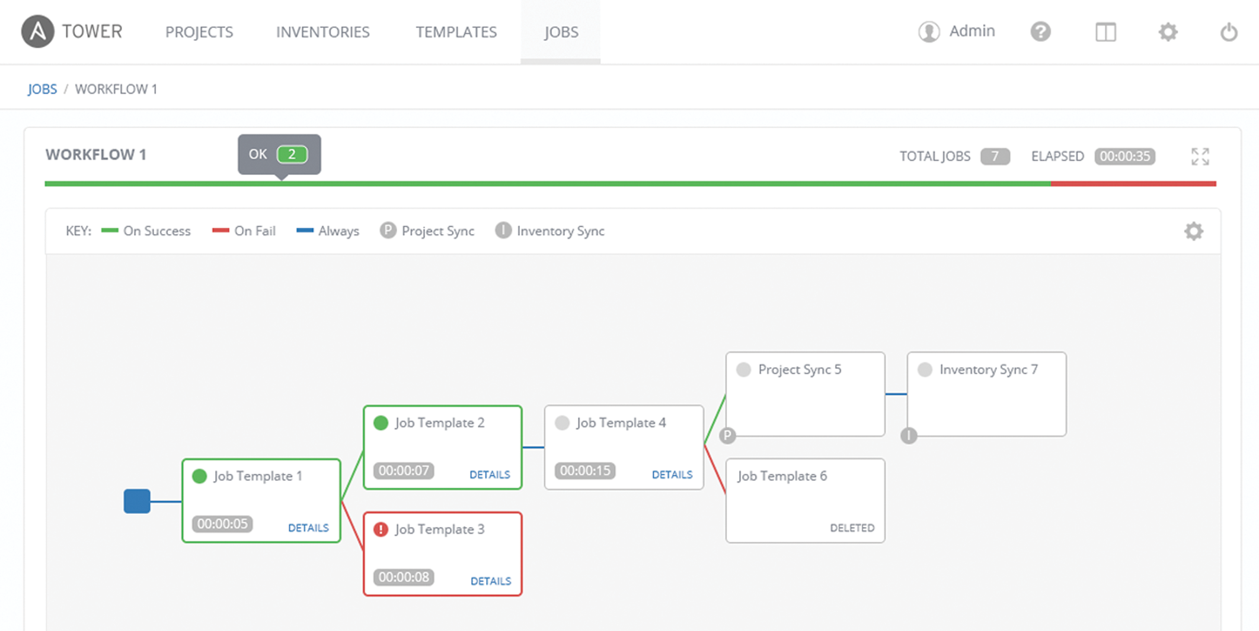
ANSIBLE TOWER
MULTI-PLAYBOOK WORKFLOWS Tower’s multi-Playbook workflows chains any number of Playbooks together to create a single workflow. Different Jobs can be run depending on success or failure of the prior Playbook.

Slide 32
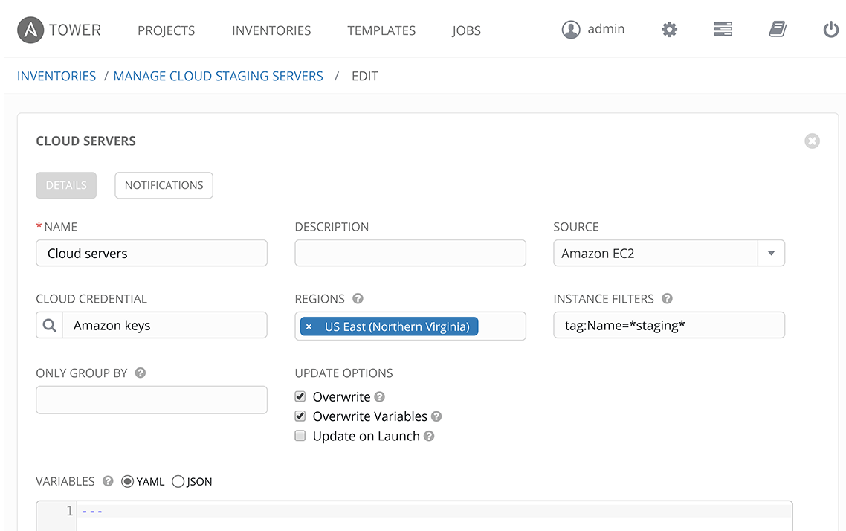
ANSIBLE TOWER
MANAGE AND TRACK YOUR INVENTORY Tower’s inventory syncing and provisioning callbacks allow nodes to request configuration on demand, enabling autoscaling.
NEW! Smart Inventories allow you to organize and automate hosts across all your providers based on a powerful host fact query engine.
NEW! See alerts from Red Hat Insights directly from Tower, and use Insights-provided Playbook Remediation to fix issues in your infrastructure.

Slide 33
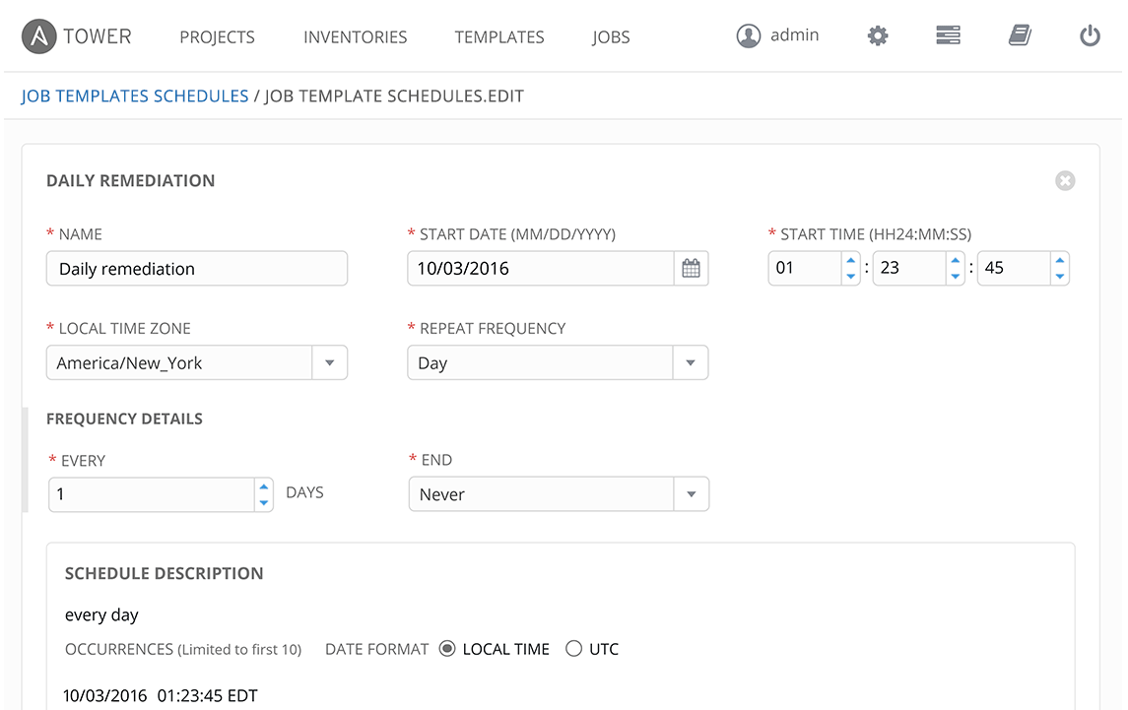
ANSIBLE TOWER
SCHEDULE JOBS Enables you to schedule any Job now, later, or forever.

Slide 34
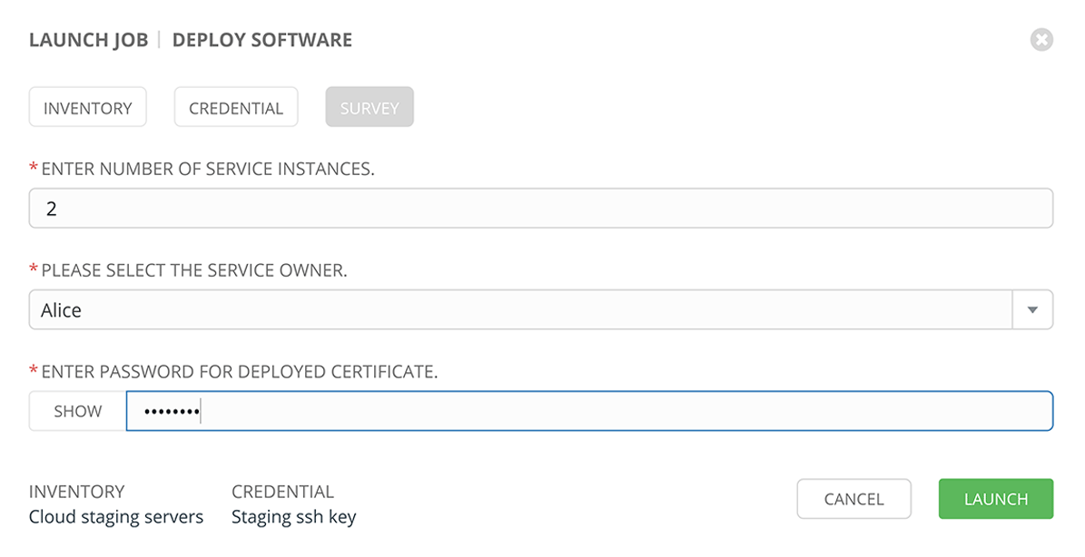
ANSIBLE TOWER
SELF-SERVICE IT Tower lets you launch Playbooks with just a single click. It can prompt you for variables, let you choose from available secure credentials and monitor the resulting deployments.

Slide 35
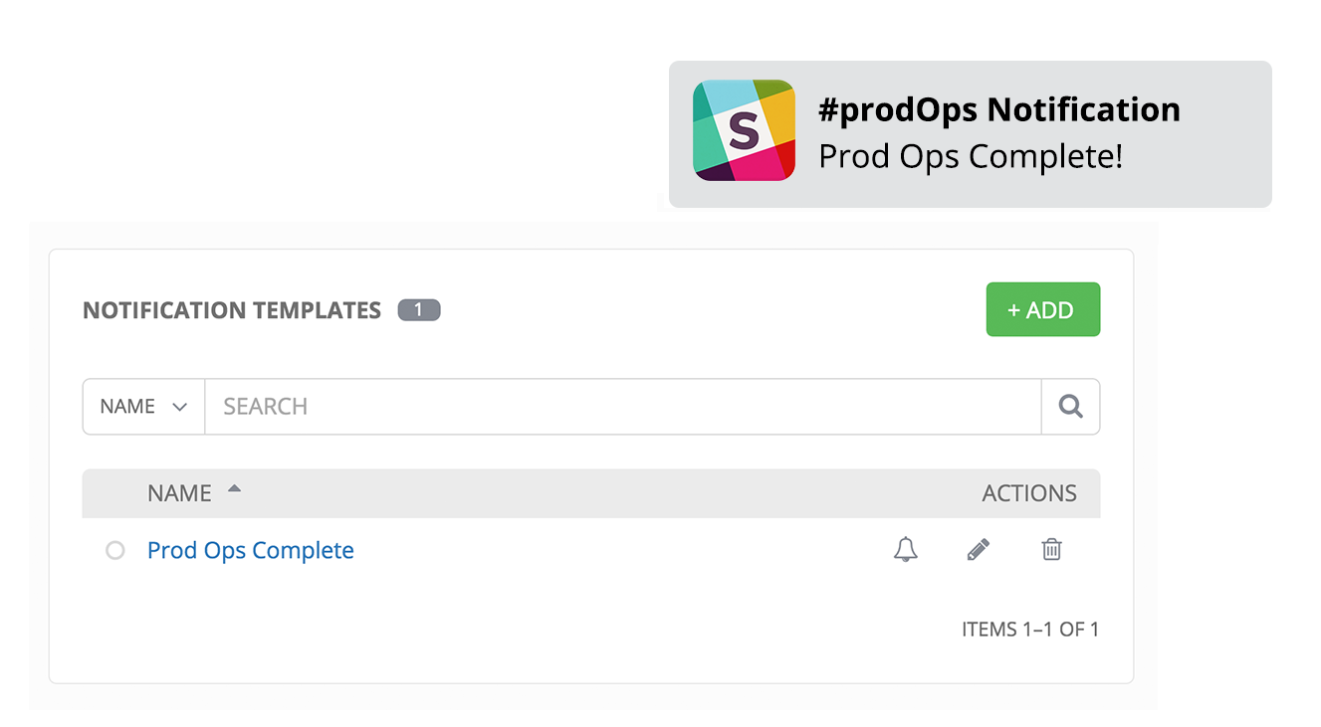
ANSIBLE TOWER
INTEGRATED NOTIFICATIONS Stay informed of your automation status via integrated notifications. Connect Slack, Hipchat, SMS, email and more.

Slide 36

AUTOMATION IS FOR HUMANS

Slide 37
THANK YOU
plus.google.com/+RedHat
facebook.com/redhatinc
linkedin.com/company/red-hat
twitter.com/RedHatNews
youtube.com/user/RedHatVideos

